Slide 1

Group - Project Online Vehicle Licensing System

Slide 2
Problem Statement
Obtaining a driving license can be challenging without a complete understanding of the required procedures.
Consequently, many individuals often rely on agents to assist in the application and acquisition of driving licenses.
To simplify this, the government has chosen to digitalize the procedure with an online platform.
Your group has been awarded this initiative, and it's imperative for you to work on and deliver the solution.
There are two types of licenses issued by RTO
Learner License (LL)
Driving License (DL)

Slide 3
Problem Statement
The DL (driving license) is a very important piece of document that is necessary to be obtained in case you plan to drive a vehicle on public roads.
There are various types of driving license:
Driving license for a motorcycle without gear: In case you need to ride a motorcycle or a scooter that doesn’t have manual gear, you need to apply for this kind of DL
Driving license for light motor vehicles: This is the type of driving license you need to apply for in case you plan to ride a two-wheeler with gears or a light motor vehicle such as cars
Driving license issued for transport vehicles: In case you wish to drive heavy motor vehicles that transport goods or passengers, you need to obtain this DL

Slide 4
Problem Statement
Application will be developed in following Sprints –
Core Java +JPA with Hibernate
Spring Boot + Rest Controller + JPA with Hibernate
Angular for UI design (Front End) + Integration with previous Sprint

Slide 5
Plan
Design
Generate the skeleton as per class design provided
TDD approach
Identify test cases for each module
Write Failing Test cases
Convert the Test Cases in GREEN
Implement the case study in incremental manner

Slide 6
Modules
RTO Officer Module
User Module
Learner License Module
Driving License Module

Slide 7
Process of obtaining Learner License (LL)
Process of obtaining Learner License:
Fill the application form
Upload the necessary documents
Pay the fees
Verify pay status
Print the receipt
Book the slot for LL

Slide 8
Process of obtaining Driving License (DL)
Process of obtaining Driving License:
Fill the application form
Upload the necessary documents
Upload the photo
Book the slot for DL test
Pay the fees
Verify the fees
Print the receipt

Slide 9
Modules
Online vehicle license application contains mainly two module:
User Module
User Registration
User Login
Schedule appointment for Learning License
Schedule appointment for Driving License Test
Cancel appointment
Attend Exam
View Result
Etc.
RTO Officer Module
Login
Manage User
Manage License
Manage Exam
Etc.

Slide 10
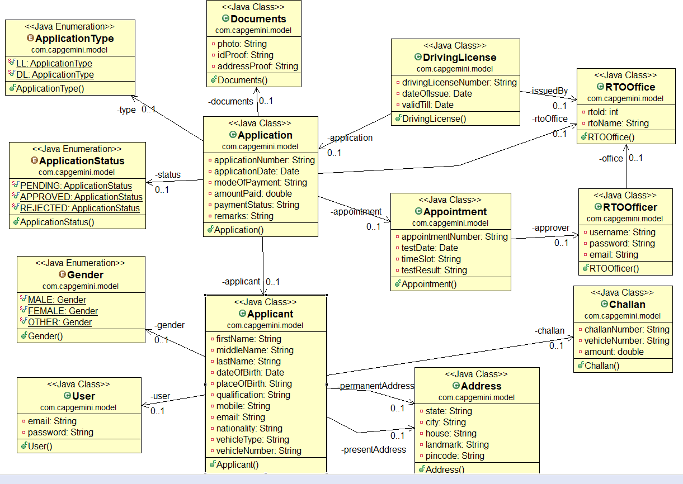
Class Diagram

Slide 11
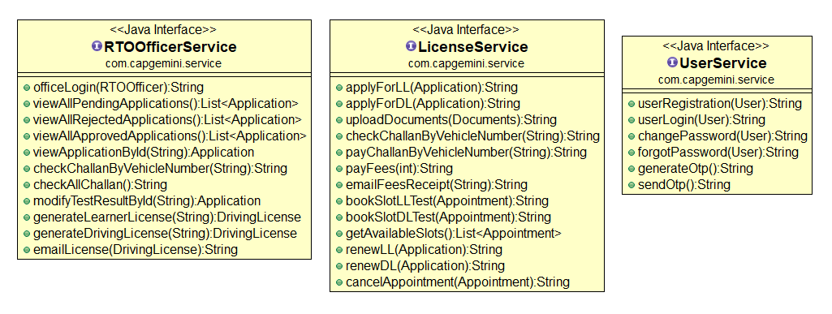
Service Interface

Slide 12
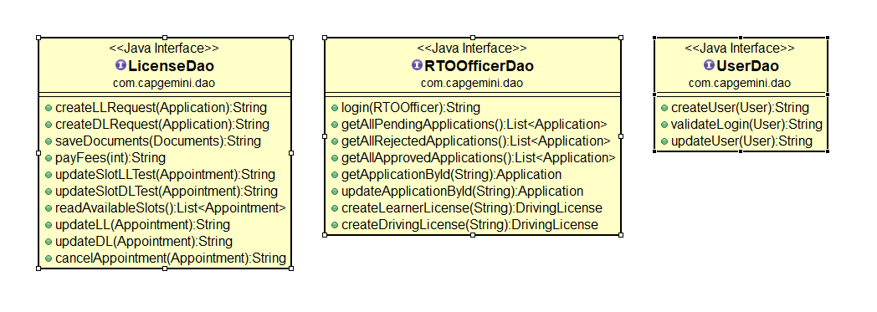
Repository

Slide 13


Slide 14
Thank You

